Slide 1
2020 IOTA North America Annual Meeting
IOTA N/A Statistics – 3 year trends
“Busy Observer” list – Top 10 for 2019
Review - Interesting North American Occultations for 2019

Slide 2
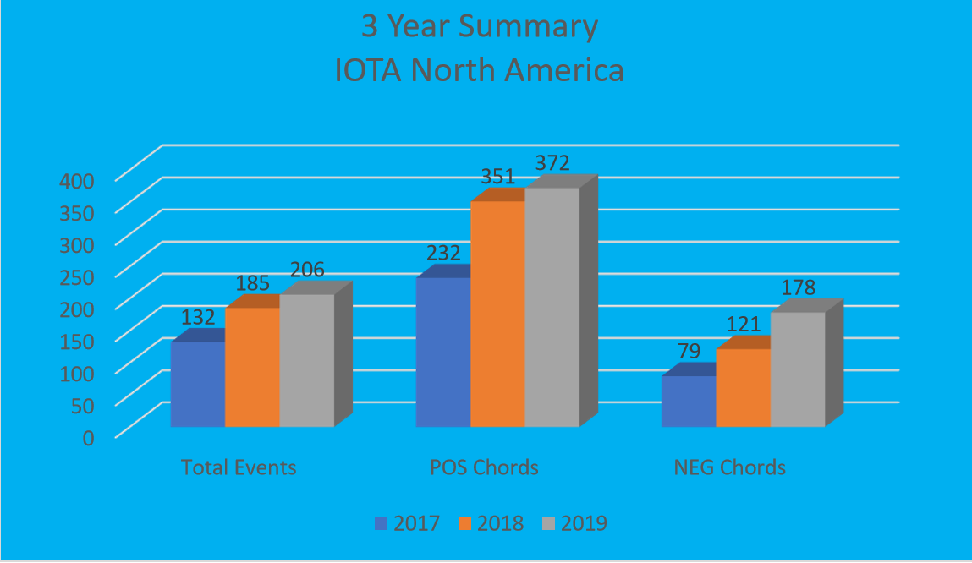
Notes:
Three year history – Trending up and expected to continue for 2020. Events all have a + and the POS and NEG chords are associated with those events. Many of the reported positive events are single POS. Also, many times a distant (non-constraining) NEG is not reported.

Slide 3
Notes:
David and Joan Dunham are prolific observers and most times deploy multiple chords. Paul Maley is very consistent observer and has by far the most positive events. Roger and Steve also deploy multiples on a regular basis and I do whenever possible. Impressive that Dave Oesper and Chris Anderson are fixed site observers. A testament to how many nights they spend observing to be able to produce that number of positives from one location. Also they file a huge number of miss reports. Tony and Wayne are also vey regular observers and take advantage of the many clear the Arizona nights. Bardecker is also a regular and also manages a RECON site near his home in Nevada. On a recent event he had an unattended pre-point station knocked over by an animal. He suspects a deer but I’m thinking it was Bigfoot.
Recognise Review Team
Jerry Bardecker
Ernie Iverson
Steve Messner
Tony G.

Slide 4
2019 Interesting Observations
07/29 (3200) Phaethon
09/29 (3200) Phaethon
10/24 (16) Psyche
01/20 (527) Euryanthe
07/16 (18) Melpomene
10/15 (144) Vibilia
12/07 (55) Pandora
12/29 (53) Leucus
08/28 (624) Hektor

Slide 5
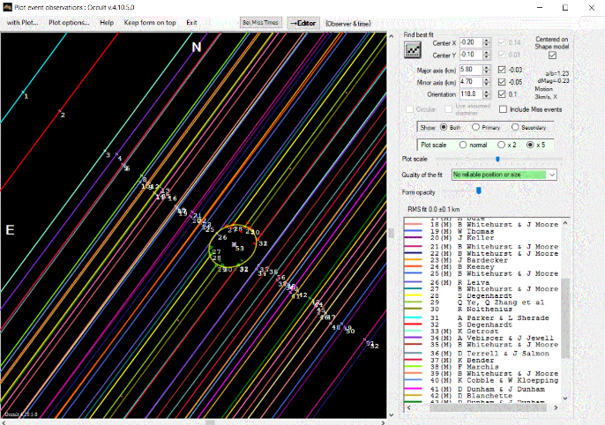
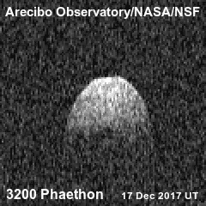
07/29/2019 (3200) Phaethon – “aka The Rock Comet” Parent of Geminids meteor shower
Large contingent – IOTA/SwRI/RECON/Others
Small and fast moving with uncertain path
Chord coordination by David Dunham
Tight chord spacing
JAXA Destiny+ target – Launch 2022 (approx)
52 Chords
6+
46-
Notes:
Large contingent – IOTA/SwRI/RECON/Others
Small and fast moving with uncertain path
Chord coordination by David Dunham
Tight chord spacing
JAXA Destiny+ target – Launch 2022 (approx)

Slide 6
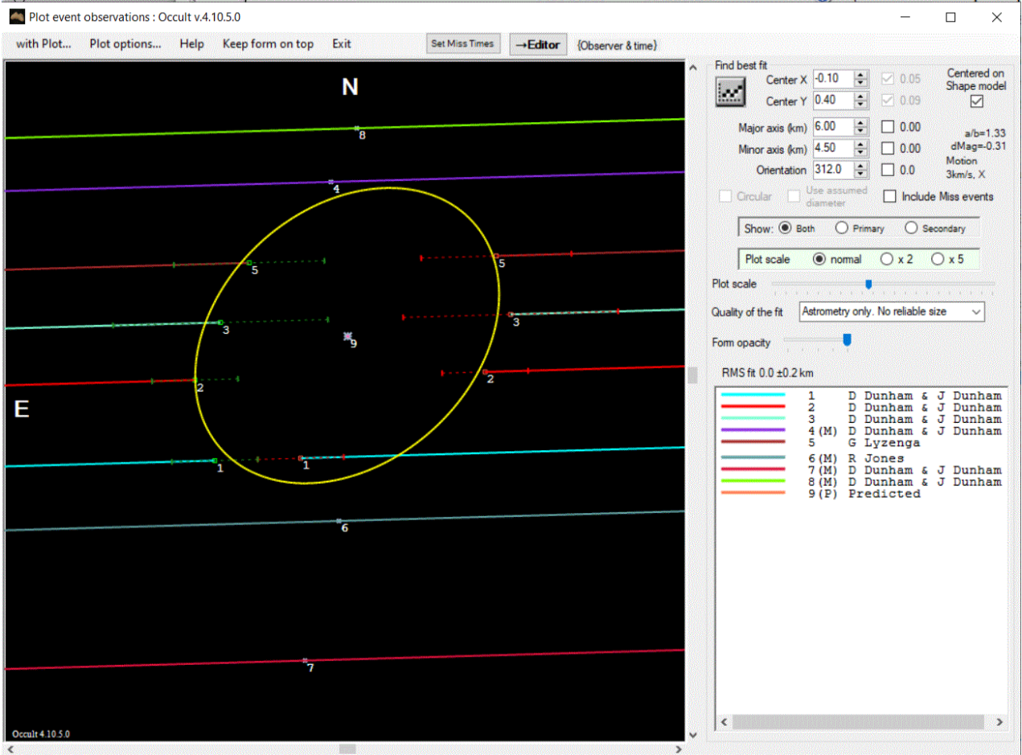
09/29/2019 (3200) Phaethon – “aka The Rock Comet” Parent of Geminids meteor shower
8 Chords
4+
4-

Slide 7
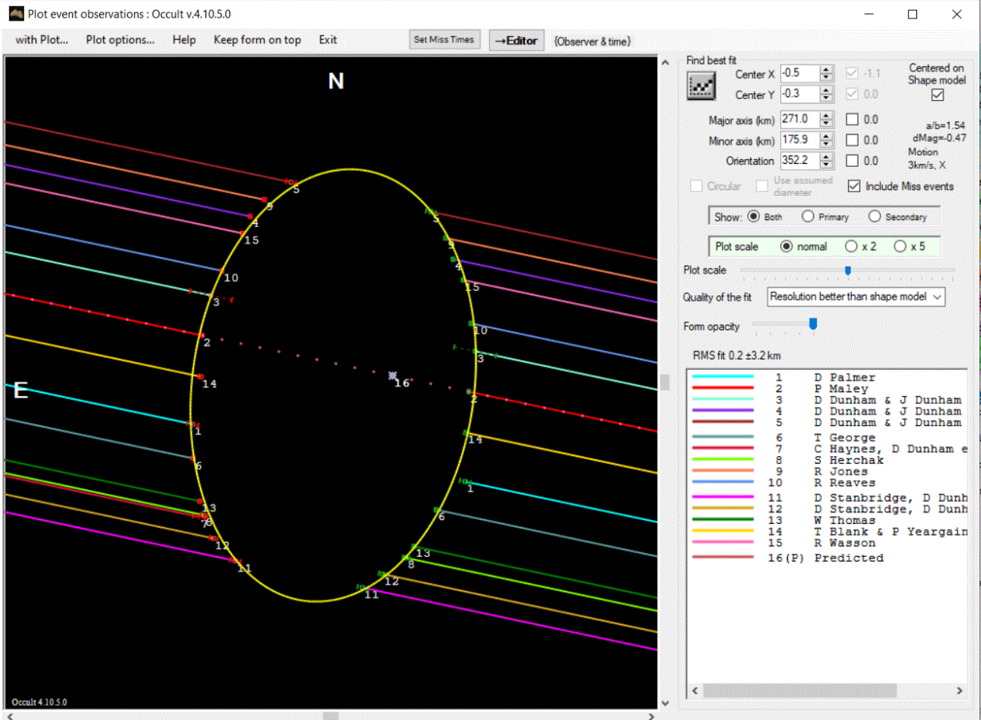
10/24/2019 (16) Psyche – 15 Chords/15 Positives – excellent fit
15 Chords
15+
0-

Slide 8
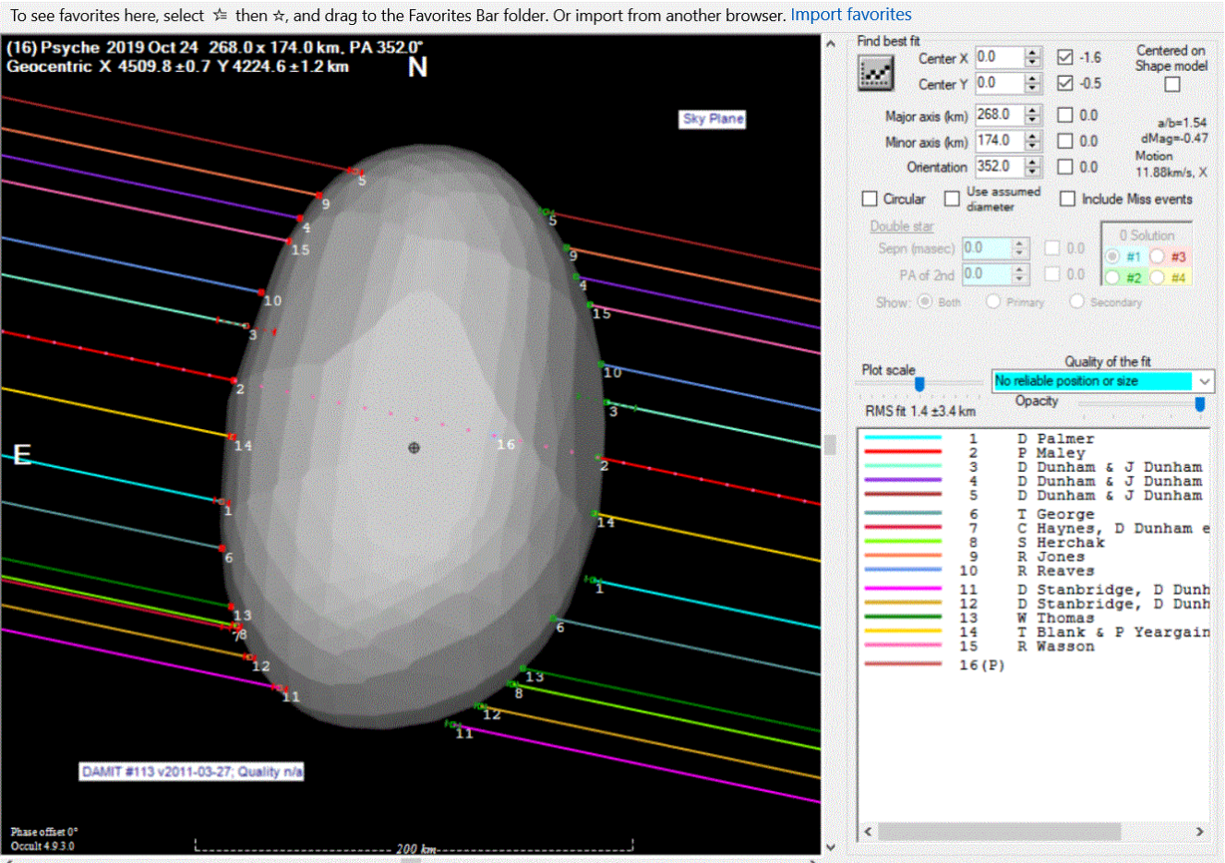
10/24/2019 (16) Psyche – 15 Chords/15 Positives – excellent fit
15 Chords
15+
0-

Slide 9
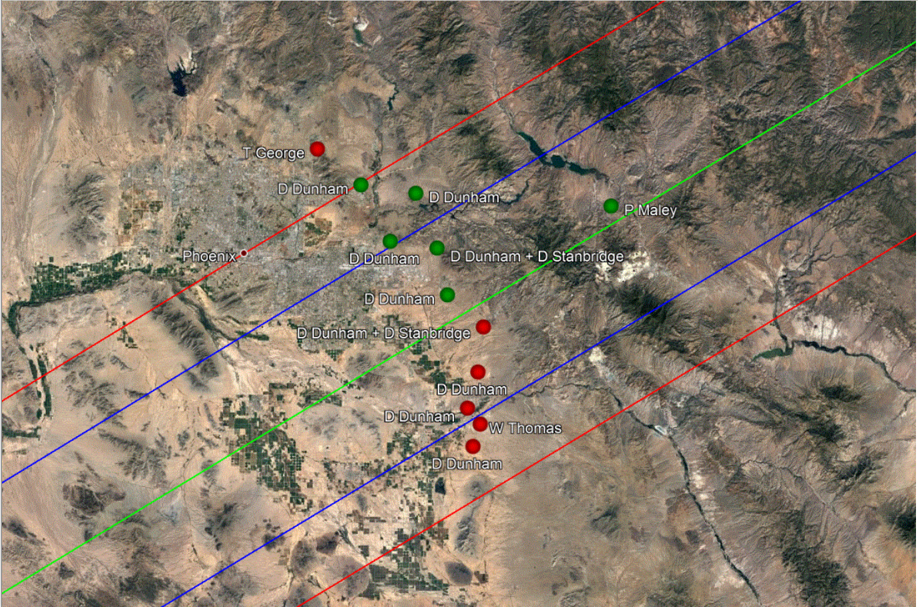
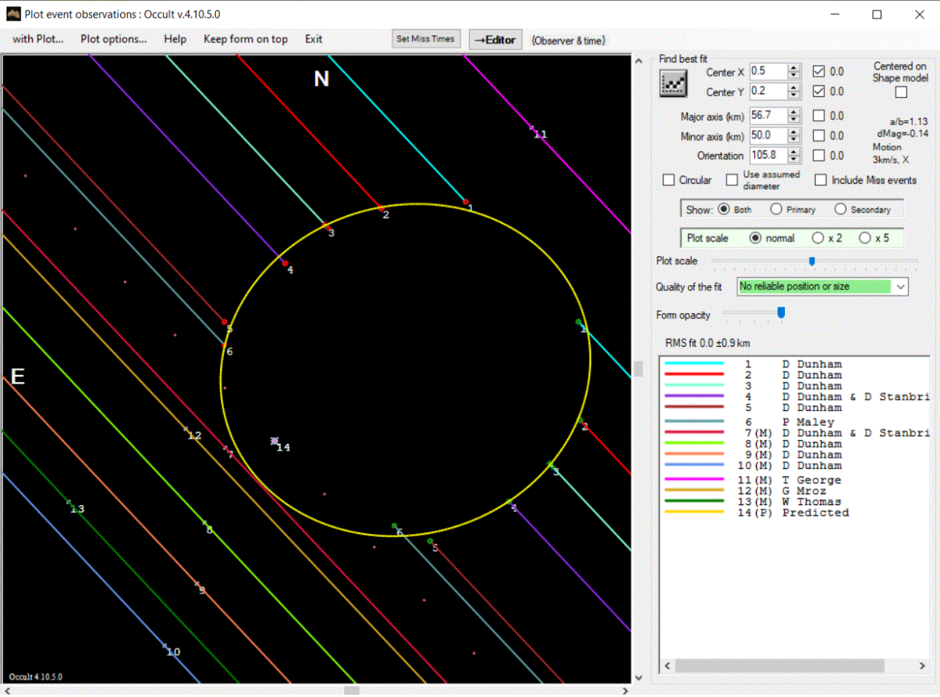
01/20/2019 (527) Euryanthe
13 Chords
6+
7-
Notes:
Good chord spread enabled complete profile despite significant path shift

Slide 10
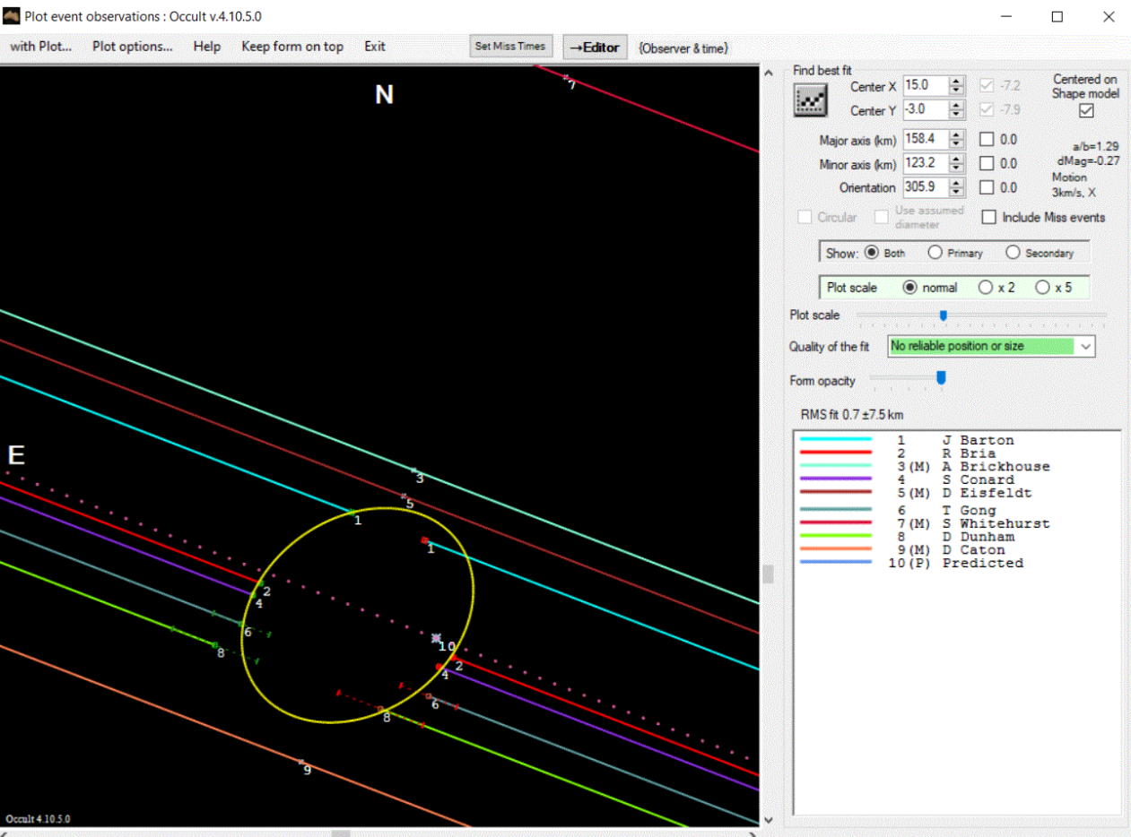
07/15/2019 (18) Melpomene
9 Chords
5+
4-

Slide 11
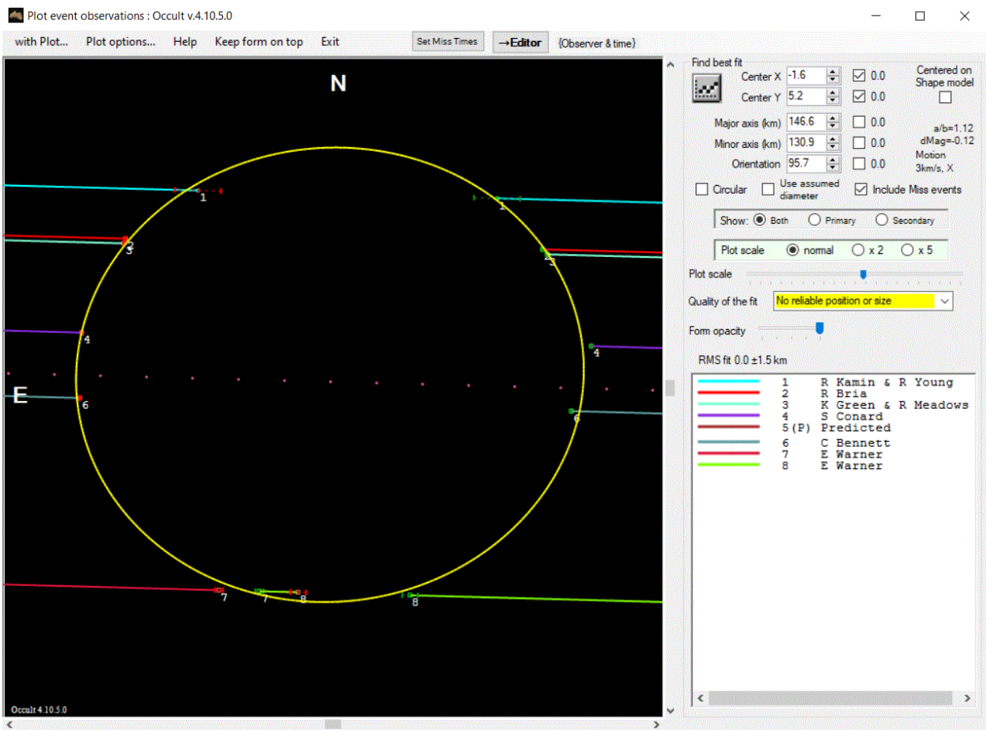
10/15/2019 (144) Vibilia
6 Chords
6+
One double+ chord
Notes:
Event for observers in the NE
Elizabeth Warner – interesting double event – concavity?

Slide 12
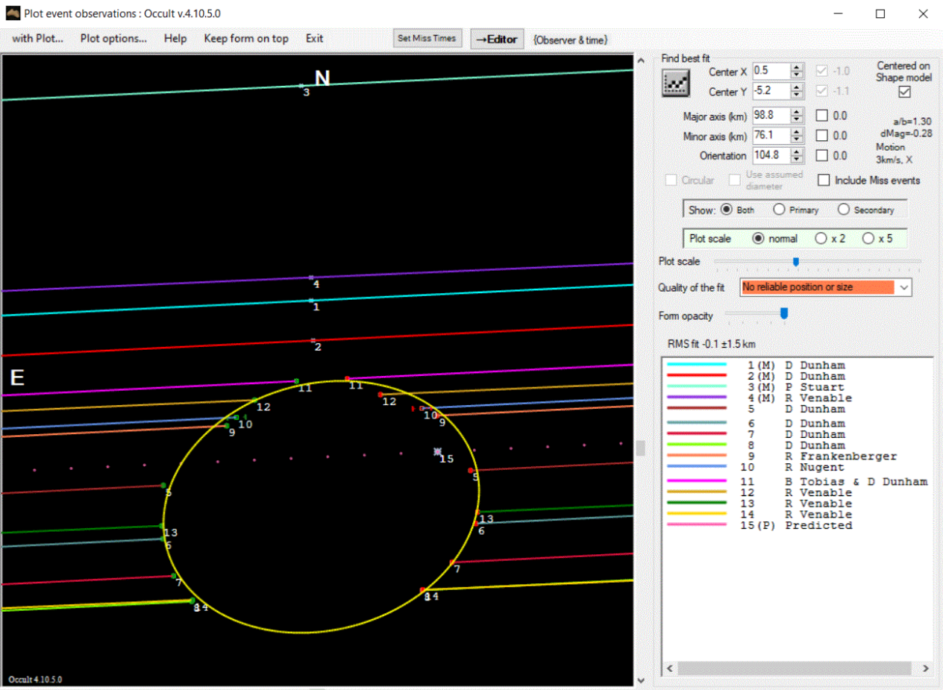
12/07/2019 (55) Pandora
14 Chords
10+
4-
Notes:
South Texas (Dunham/Tobias Hwy 16 Nugent, Frankenberger, Stuart) and North Florida (Venable)

Slide 13
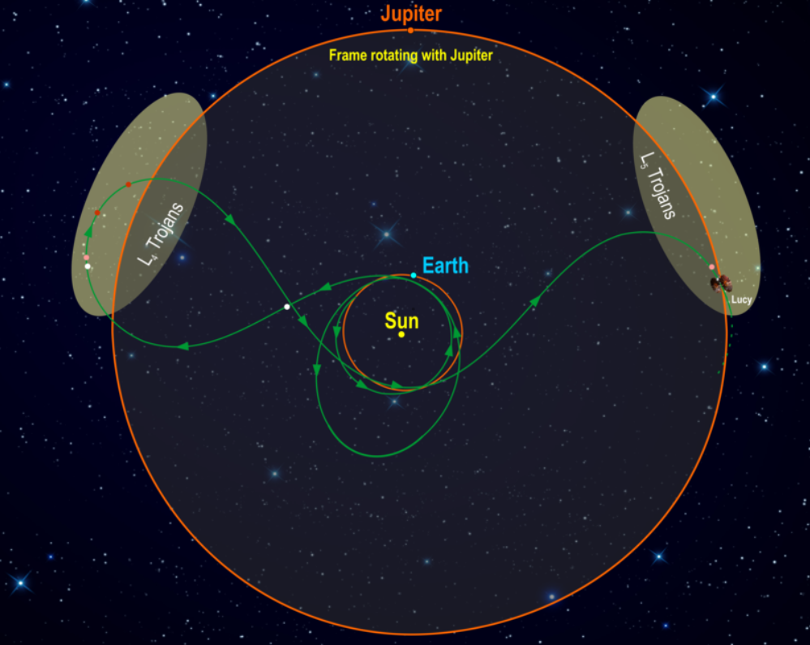
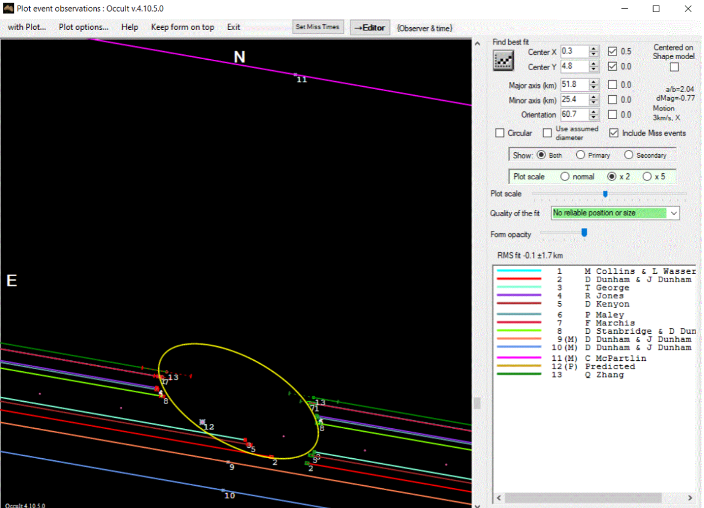
12/29/2019 (53) Leucus
12 Chords
9+
3-
One of the targets for NASA/Lucy Mission
Launch 10/2021
8 total asteroids
7 Trojan and 1 MB
Notes:
This diagram illustrates NASA/Lucy mission orbital path. The spacecraft’s path (green) is shown in a frame of reference where Jupiter remains stationary, giving the trajectory its pretzel-like shape. After launch in October 2021, Lucy has two close Earth flybys before encountering its Trojan targets. In the L4 cloud Lucy will fly by (3548) Eurybates (white) and its satellite, (15094) Polymele (pink), (11351) Leucus (red), and (21900) Orus (red) from 2027-2028. After diving past Earth again Lucy will visit the L5 cloud and encounter the (617) Patroclus-Menoetius binary (pink) in 2033. As a bonus, in 2025 on the way to the L4, Lucy flies by a small Main Belt asteroid, (52246) Donaldjohanson (white), named for the discoverer of the Lucy fossil. After flying by the Patroclus-Menoetius binary in 2033, Lucy will continue cycling between the two Trojan clouds every six years.
Credits: Southwest Research Institute

Slide 14
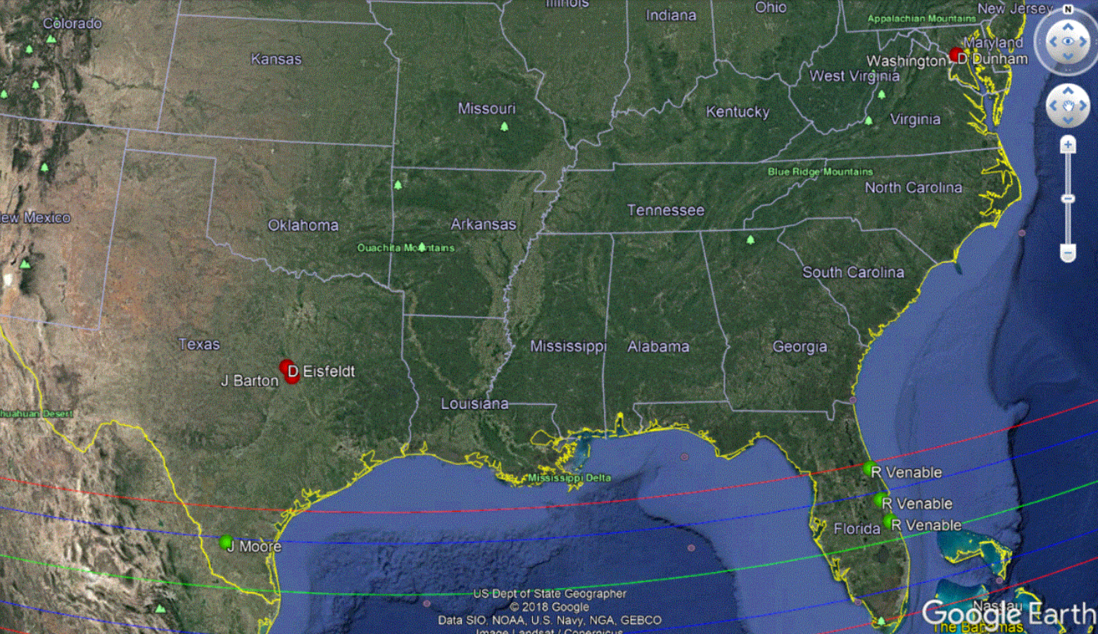
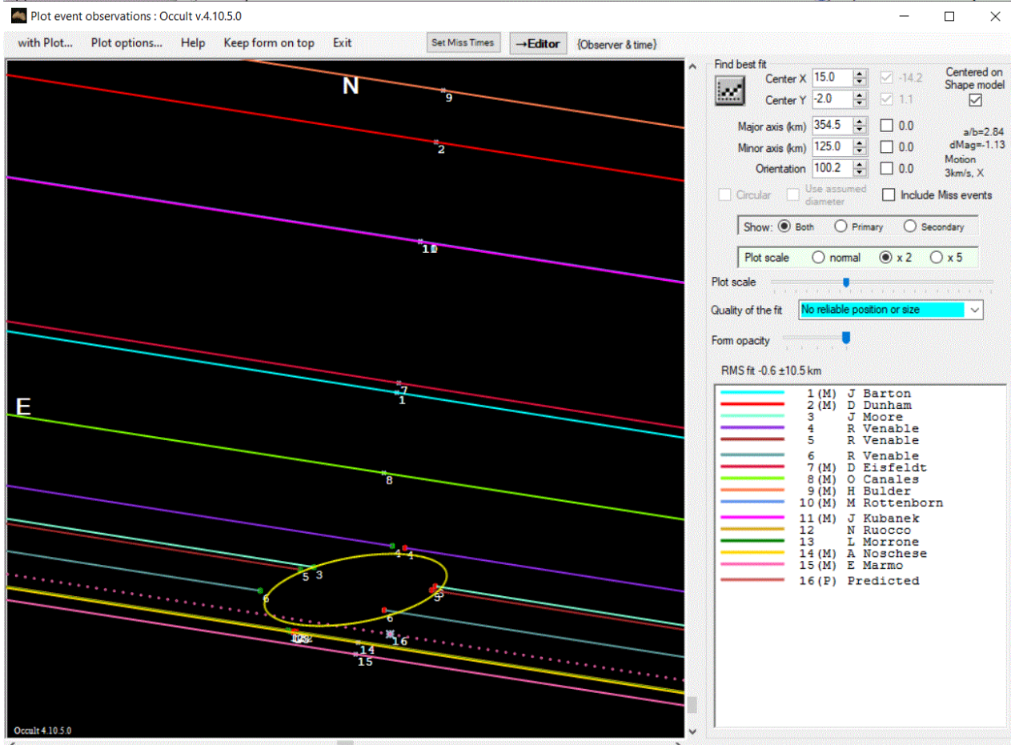
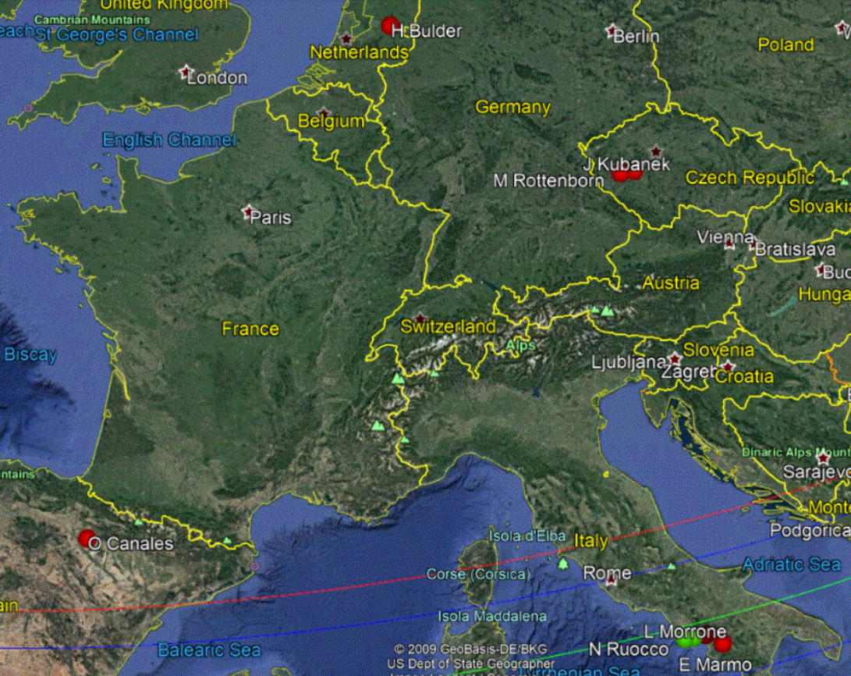
08/28/2019 (624) Hektor – International Event

Slide 15
Thank You!!
Keep up the good work!!

